Slide 1
Blender Project
Modelling a Pokémon Center
Team Rocket:
José Fernando Dávila
Julio César Aguilar
José Carlos Villarreal

Slide 2
Introduction

Slide 3
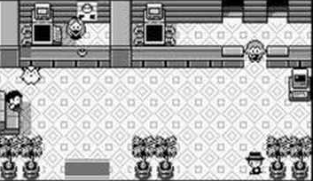
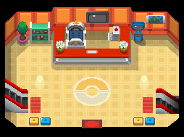
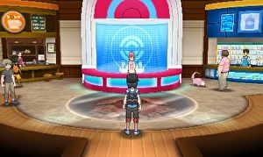
Introduction
Our scene depicts our interpretation of a Pokémon Center, inspired by the ones presented in the games and the TV show. It has a service counter, a resting area, a conversation area, a window, and a glass door.
A Pokémon Center is a place where a person that trains Pokémon can go to and recover after a battle, they are key elements of the “Pokémon World”. They represent a safe haven for the player (Pokémon Trainers). Fundamental locations of the Pokémon games and recurrent along the 20 years of history.
The motivation behind our choice is our background playing and watching Pokémon related content when we were younger. Furthermore, Pokémon is a theme with which we are familiar and inspires creativity in us to create 3D models of our own. The chosen topic also has social implications that we perceive.
Sources of the images:
(1) https://i.ytimg.com/vi/MjZIjHu0OfY/hqdefault.jpg
(2) https://cdn.bulbagarden.net/upload/1/14/Pok%C3%A9mon_Center_inside_DPPt.png
(3) http://images.eurogamer.net/2015/articles/1/8/6/2/7/2/5/pokemon-sun-and-moon-
demo-guide-how-to-unlock-ash-greninja-in-the-full-game-147672490344.jpg/EG11/resize/300x-1/quality/80/format/jpg

Slide 4
Modelling

Slide 5
Original Models
List models developed by the team
Briefly, describe the procedure to generate the objects you feel more strongly about
List Imported models
State imported models origin

Slide 6
Original Models – Developed by the team
Couches
Counter
Counter tray
Pokéball shaped lamps
Screens
Screen and statue base (corner)
Clock
Book Shelf

Slide 7
Procedure to create significant objects
Showcase with TV base:
Objective: Build a showcase to be arranged in the corner of the layout, having a radius of 1.5 units.
We created a Cylinder with 3 units of diameter.
Using the knife tool, we added edges to the cylinder and separated it in two.
We repeated step 2. in order of obtaining one third of the original cylinder., and adjusted the size to have the desired height for the bottom base.
We selected the edges of the sharp corner of the object and added faces with Blender’s “F” command.
We selected the edges on the top shape of the base, added new vertices with “E”, scaled (“S”) them two units to get the middle part of the showcase. Then, we did the same adding the last segment of 1 unit of height.
We separated each segment and added materials and textures as needed. The middle part has a Glass BSDF material to make it invisible

Slide 8
Imported Models
Computer
Chairs
Books

Slide 9
Origin of Imported Models

Slide 10
Layout and Composition
Describe your general Layout
For the most important objects, describe why their are placed in the scene in such way

Slide 11
Cameras

Slide 12
Illumination
Describe the illumination scheme
Describe why you chose such illumination scheme

Slide 13
Cameras
Describe your camera setup
For each camera, describe the type of scene you are creating (closeup, reverse, pov, etc), the lenses and the aspect ratio (width vs height)
Describe why views are interesting
Discuss if shadows give you more realism

Slide 14
Conclusions

Slide 15
Technical Conclusions
Discuss technical issues you encountered
Describe important facts, actions and observations
Discuss additional thoughts about the project

Slide 16
Ethical Conclusions
Discuss how your project relates to our responsibilities as a professionals
If you wish, discuss how you project relates to human morality

Slide 17
Citizenship Conclusions
Discuss how your project relates to our responsibilities as citizens of a community, a country and the world
Discuss how the project relates to your immediate community

Slide 18
Environmental Conclusions
Discuss how your project relates to our responsibilities for our environment
Also discuss further thoughts you may have

Slide 19
References
https://www.pokemon.com/es/pokedex/pikachu

